Slide 2
De-mystifying Deep Learning
Anusua Trivedi
Data Scientist
Email: antriv@microsoft.com Twitter: @anurive

Slide 3
Talk Outline
Deep Learning (DL)
Deep Neural Networks (DNN)
Types of DNNs
DL Frameworks
Use Cases

Slide 4
Resources
https://aka.ms/mlads2016_deeplearning

Slide 5
Traditional ML Vs DL
Traditional ML requires manual feature extraction/engineering
Feature extraction for unstructured data is very difficult
Deep learning can automatically learn features in data​
Deep learning is largely a "black box" technique, updating learned weights at each layer

Slide 6
Why is DL popular?
DL models has been here for a long time
Fukushima (1980) – Neo-Cognitron
LeCun (1989) – Convolutional Neural Network
DL popularity grew recently
With growth of Big Data
With the advent of powerful GPUs

Slide 7
Deep learning begins with a little function
It all starts with a humble linear function called a perceptron.
weight1 ✖ input1
weight2 ✖ input2
weight3 ✖ input3
sum
Perceptron:
If sum > threshold: output 1
Else: output 0
✚
Example: The inputs can be your data. Question: Should I buy this car?
0.2 ✖ gas mileage
0.3 ✖ horsepower
0.5 ✖ num cup holders
sum
Perceptron:
If sum > threshold: buy
Else: walk
✚

Slide 8
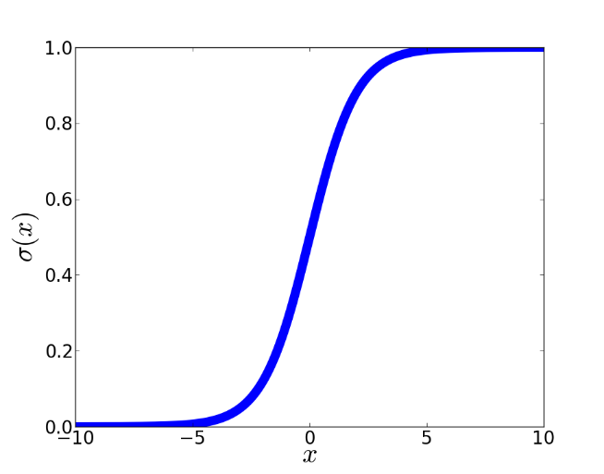
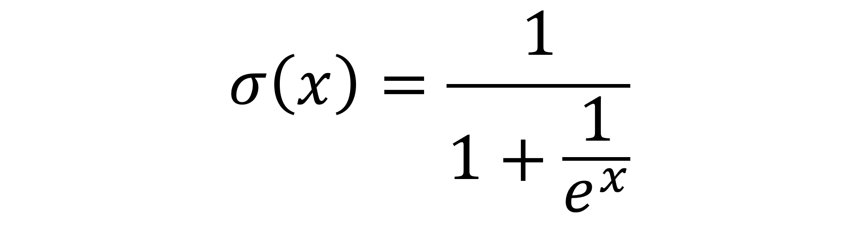

These little functions are chained together
Deep learning comes from chaining a bunch of these little functions together. Chained together, they are called neurons.
To create a neuron, we add a nonlinearity to the perceptron to get extra representational power when we chain them together.
Our nonlinear perceptron is sometimes called a sigmoid.
where
The value b just offsets the sigmoid so the center is at 0.
Plot of a sigmoid

Slide 9
Single artificial neuron
Output, or input to next neuron
weight3 ✖ input3
weight1 ✖ input1
weight2 ✖ input2

Slide 10

Deep Neural Network (DNN)
*http://neuralnetworksanddeeplearning.com/chap5.html

Slide 11
Common DNNs
Deep Convolutional Neural Network (DCNN)
To extract representation from images
Recurrent Neural Network (RNN)
To extract representation from sequential data
Deep Belief Neural Network (DBN)
To extract hierarchical representation from a dataset

Slide 12
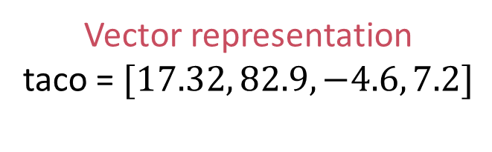
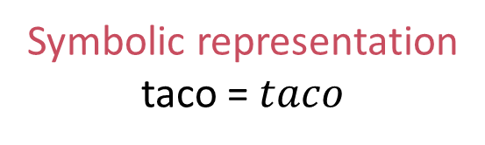
Comparing Representations
Vector representation
taco = $[17.32, 82.9, −4.6, 7.2]$
Symbolic representation taco = $taco$
Vectors have a similarity score.
A taco is not a burrito but similar.
Symbols can be the same or not.
A taco is just as different from a burrito as a Toyota.
Vectors have internal structure [Mikolov et al., 2013].
Italy – Rome = France – Paris
King – Queen = Man – Woman
Symbols have no structure.
Vectors are grounded in experience.
Meaning relative to predictions.
Symbols are arbitrarily assigned.
Meaning relative to other symbols.

Slide 13
Common Open-Source DL Frameworks
Non-symbolic
Symbolic
Torch, Caffe
Manual optimization
Memory intensive
CNTK, MXNET, Theano, TensorFlow
Automatic optimization
Memory reuse
Notes:
In a non-symbolic or imperative framework, a program is executed in a given order
A symbolic framework is a tensor graph of vector operations, such as matrix add/multiply or convolution
It allows users to invent new complex layer types without implementing them in a low-level language

Slide 14
Deep learning and computer vision

Slide 15
Vision is hard
Vision is hard because images are big matrices of numbers.
How a computer sees an image [22, 81, 44, 88, 17, 0, ..., 45]
Even harder for 3D objects.
You move a bit, and everything changes.
Example from MNIST handwritten digit dataset [LeCun and Cortes, 1998].

Slide 16
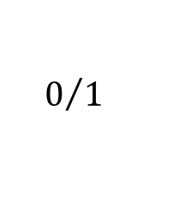
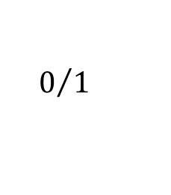
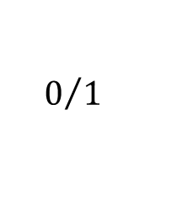
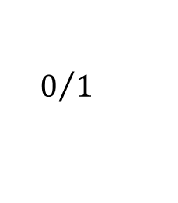
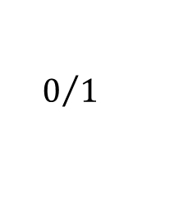
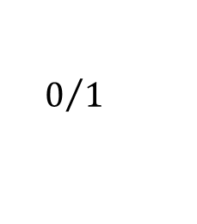
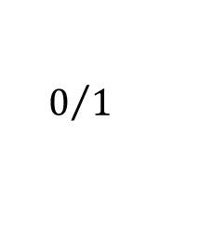
RBM: Unsupervised Model
Stochastic binary neuron
Probabilistically outputs 0 (turns off) or 1 (turns on) based on the weight of the inputs from on units.
$$0/1$$
Limit connections to be from one layer to the next.
Fast because decisions are made locally.
Trained in an unsupervised way to reproduce the data.
$$0/1$$
$$0/1$$
$$0/1$$
$$0/1$$
$$0/1$$
$$0/1$$
Notes:
Big breakthrough in 2006 by Hinton et al.
Use a network with symmetric weights called a restricted Boltzmann machine.

Slide 17
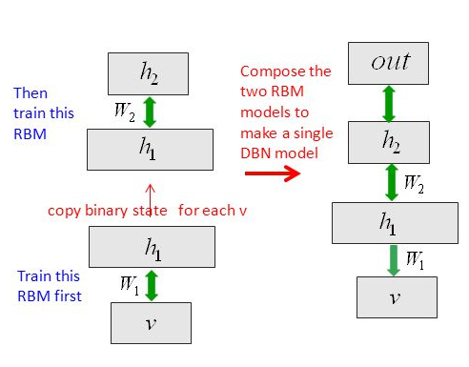
Stack up the layers to make a DBN
*Huang et al., Communications ACM 01/2014
Notes:
DBN:
A model by Hinton et al.
RBMs can be stacked and trained in a greedy manner to form so-called Deep Belief Networks
DBNs can extract a deep hierarchical representation of the training data e.g music autofill

Slide 18
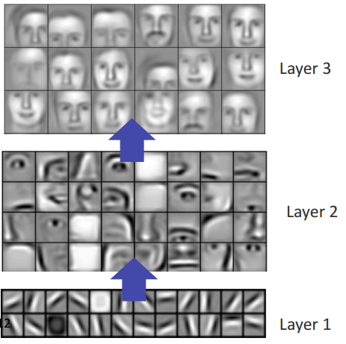
Computer vision, scaling up
Unsupervised learning was scaled up by Honglak Lee et al. [2009] to learn high-level visual features.
Further scaled up by Quoc Le et al. [2012].
Used 1,000 machines (16,000 cores) running for 3 days to train 1 billion weights by watching YouTube videos.
The network learned to identify cats.
The network wasn’t told to look for cats, it naturally learned that cats were integral to online viewing.
[Lee et al., 2009]

Slide 19
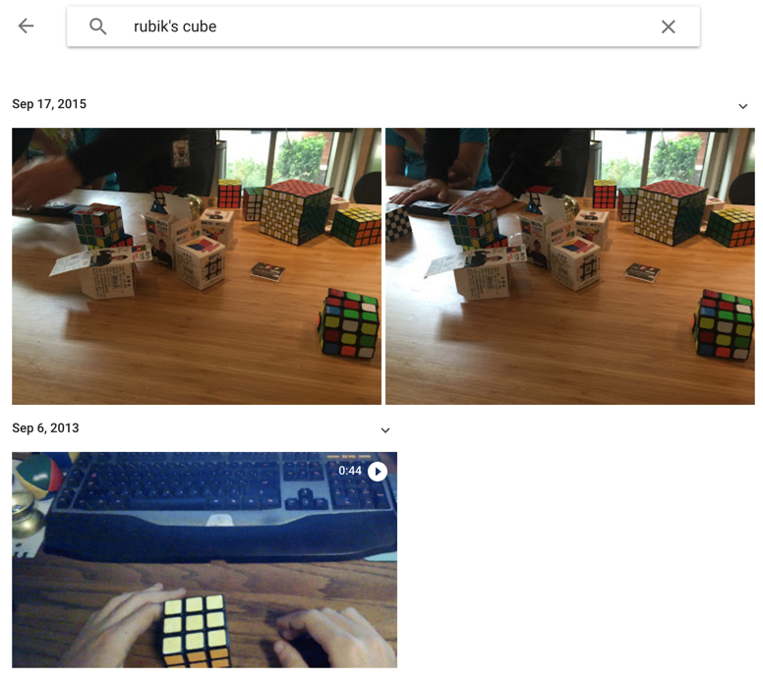
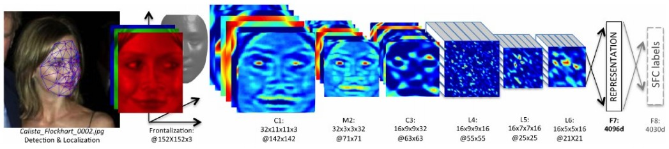
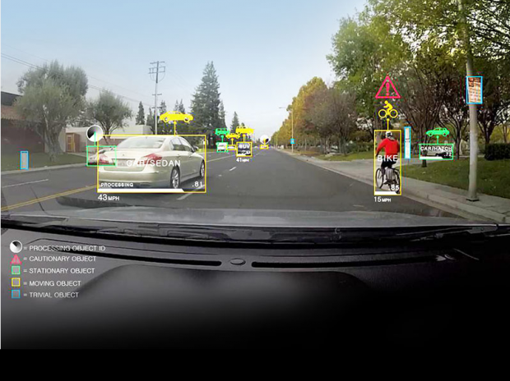
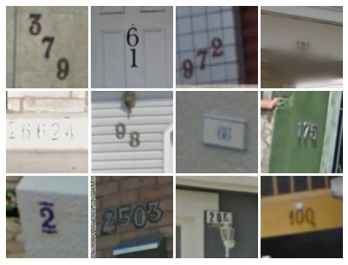
Supervised: ConvNets are everywhere
Face Verification, Taigman et al. 2014 (FAIR)
e.g. Google Photos search
[Goodfellow et al. 2014]
Self-driving cars
*Andrej Karpathy’s recent presentation

Slide 20
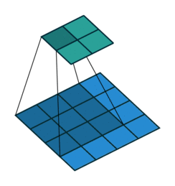
Convolution Layer
Filters always extend the full depth of the input volume
32x32x3 image
5x5x3 filter
32
Convolve the filter with the image
i.e. “slide over the image spatially, computing dot products”
Convolving a 3 X 3 kernel over a 4 X 4 input
32
3
*Andrej Karpathy’s recent presentation
*http://iamaaditya.github.io/2016/03/one-by-one-convolution/

Slide 21

Pooling layer
makes the representations smaller and more manageable
operates over each activation map independently
*Andrej Karpathy’s recent presentation
Notes:
It is also referred to as a down sampling layer. In this category, there are also several layer options, with max pooling being the most popular. This basically takes a filter (normally of size 2x2) and a stride of the same length. It then applies it to the input volume and outputs the maximum number in every subregion that the filter convolves around.
As you can imagine, this layer drastically reduces the spatial dimension of the input volume. This serves two main purposes. The first is that the amount of parameters or weights is reduced by 75%, thus lessening the computation cost. The second is that it will control overfitting

Slide 22
Max Pooling
Single depth slice
1 | 1 | 2 | 4
5 | 6 | 7 | 8
3 | 2 | 1 | 0
1 | 2 | 3 | 4
x
max pool with 2x2 filters and stride 2
6 | 8
3 | 4
y
*Andrej Karpathy’s recent presentation

Slide 23

Fully Connected Layer (FC layer)
*Andrej Karpathy’s recent presentation
Notes:
Contains neurons that connect to the entire input volume, as in ordinary Neural Networks

Slide 24
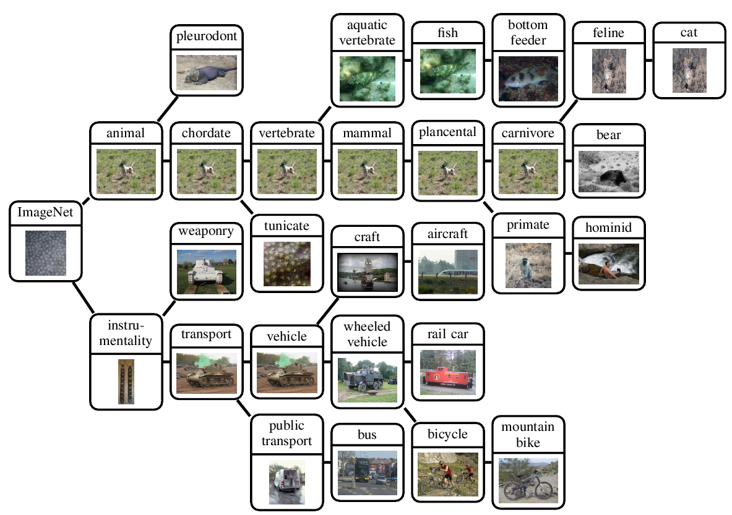
IMAGENET
*http://groups.inf.ed.ac.uk/calvin/imagenet/prototypes.html
Notes:
An image database of 1 million natural images
It has 1000 labels
It has been used in multiple image competitions and is used as standard
Berkley Vision and Learning center (BLVC) have trained DNN models on ImageNet, and made the pre-trained weights publicly available.

Slide 25
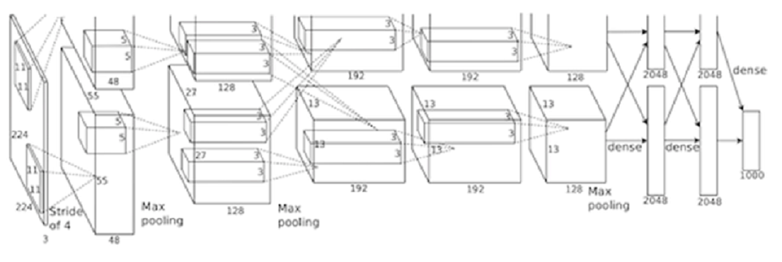
AlexNet
*https://papers.nips.cc/paper/4824-imagenet-classification-with-deep-convolutional-neural-networks.pdf
Notes:
Developed by Krizhevsky, Sutskever, and Hinton in 2012
Record breaking performance on ImageNet dataset
Utilizes data augmentation and dropout

Slide 26
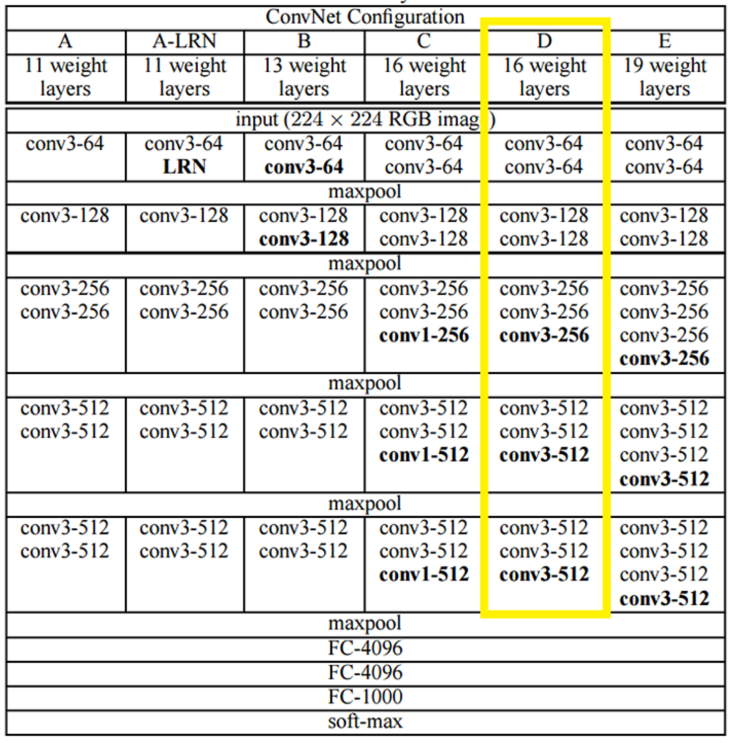
VGGNet
*http://arxiv.org/pdf/1409.1556v6.pdf
Notes:
Karen Simonyan and Andrew Zisserman of the University of Oxford created a 19 layer CNN
It used 3x3 filters with stride and pad of 1, along with 2x2 maxpooling layers with stride 2
It reinforced the notion that convolutional neural networks have to have a deep network of layers in order for the hierarchical representation of visual data to work

Slide 27
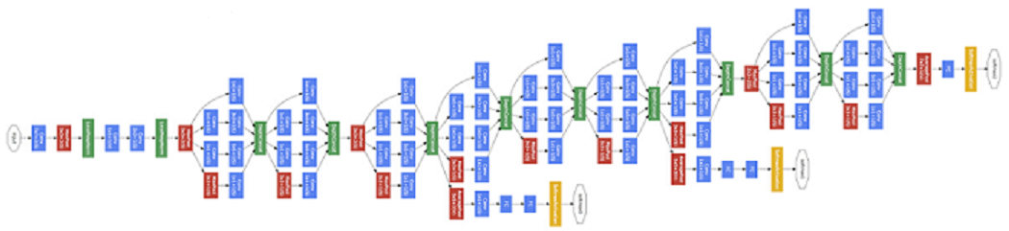
GoogLeNet
*http://www.csc.kth.se/~roelof/deepdream/bvlc_gnet.html
Notes:
GoogLeNet is a 22 layer CNN and was the winner of ILSVRC 2014 with a top 5 error rate of 6.7%.
GoogLeNet was one of the first models that introduced the idea that CNN layers didn’t always have to be stacked up sequentially.
This model places notable consideration on memory and power usage.
However, stacking all of these layers and adding huge numbers of filters has a computational and memory cost, as well as an increased chance of overfitting.
I often use a L2 regularizer to avoid overfitting.

Slide 28
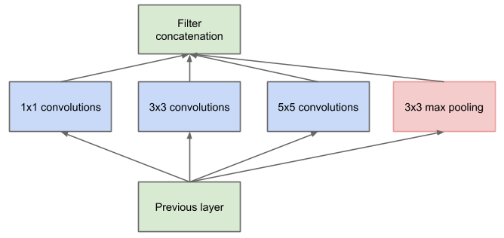
GoogLeNet uses Inception
Inception Module
*https://arxiv.org/pdf/1409.4842v1.pdf
Notes:
In GoogLeNet not everything is happening sequentially. Pieces of this network are happening in parallel.
The bottom green box is our input and the top one is the output of the model. Inception module allows us to perform convolution and pooling operations in parallel.
Inception module creates a network in network convolution, which extracts information about the very fine grain details in the volume.
Inception module also have a pooling operation that helps to reduce spatial sizes and combat overfitting.
Inception modules have ReLUs after each conv layer, which helps improve the nonlinearity of the network.
Thus, the network is able to perform the functions of these different operations while still remaining computationally considerate.

Slide 29
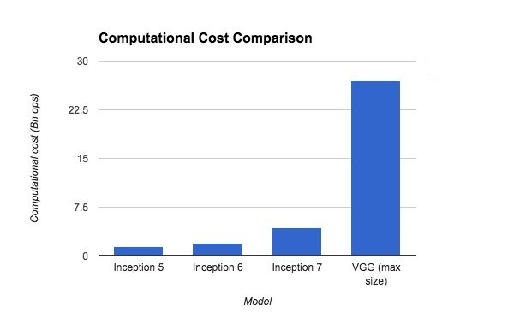
Inception Performance comparison
*http://lsun.cs.princeton.edu/slides/Christian.pdf

Slide 30
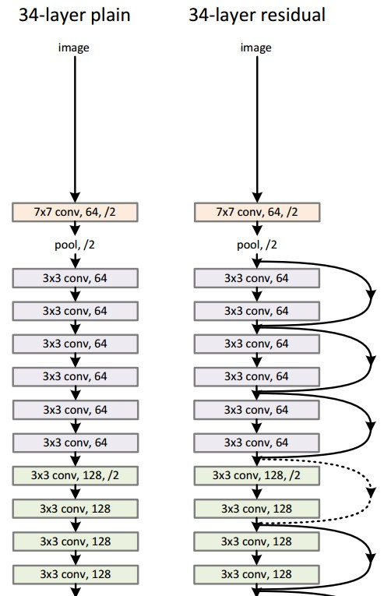
Microsoft ResNet
*https://arxiv.org/pdf/1512.03385v1.pdf
Notes:
ResNet is a model by MSR
It is a very deep network architecture with 152 layers
ResNet won ILSVRC 2015 with an incredible low error rate of 3.6%
It sets new records in classification, detection, and localization

Slide 31
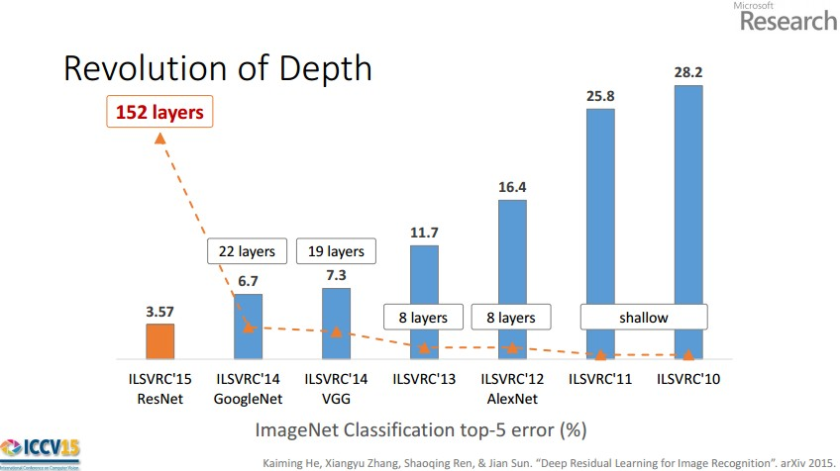
*Andrej Karpathy’s recent presentation

Slide 32
Deep learning and natural language processing

Slide 33
Deep learning enables sub-symbolic processing
I
bought
a
car
.
<i>
<bought>
<a>
<car>
<.>
You have to remember to represent “purchased” and “automobile.”
What about “truck”?
How do you encode the meaning of the entire sentence?

Slide 34
But what about a sentence?
Algorithm for generating vectors for sentences
Make the sentence vector be the vector for the first word.
For each subsequent word, combine its vector with the sentence vector.
The resulting vector after the last word is the sentence vector.
Can be implemented using a recurrent neural network (RNN)

Slide 35
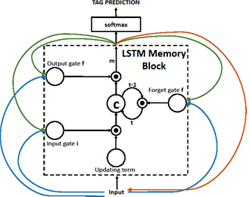
LSTM RNN
*Huang et al., Communications ACM 01/2014
Notes:
RNN:
Recurrent neural networks (RNN) are networks with loops in them, allowing information to persist.
Long Short Term Memory (LSTM) networks are a special kind of RNN, capable of learning long-term dependencies.
Good for state-wise (step-by-step) caption generation task.

Slide 36
What can you do with a Sentence Vector?
You can feed it to a classifier.
You can unwind in the other direction to do machine translation.
Called a seq2seq model, or Neural Machine Translation, or encoder-decoder model.

Slide 37
Deep learning and question answering
Bob went home.
Tim went to the junkyard.
Bob picked up the jar.
Bob went to town.
Where is the jar? A: town
Memory Networks [Weston et al., 2014]: Updates memory vectors based on a question and finds the best one to give the output.
The office is north of the yard.
The bath is north of the office.
The yard is west of the kitchen.
How do you go from the office to the kitchen? A: south, east
Neural Reasoner [Peng et al., 2015]: Encodes the question and facts in many layers, and the final layer is put through a function that gives the answer.

Slide 38
Other commonly used DNNs

Slide 39
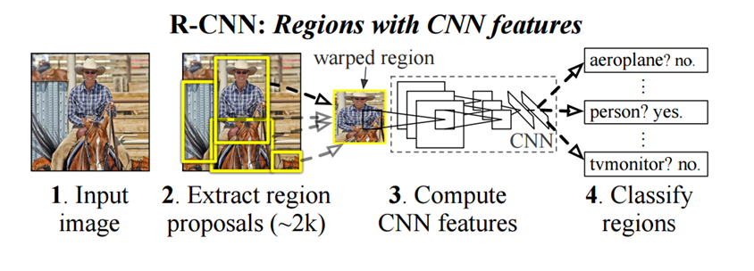
Region Based CNN (RCNN)
*https://arxiv.org/pdf/1311.2524v5.pdf
Notes:
Ross Girshick and his group at UC Berkeley created this model
Determines a specific object’s exact location
RCNNs has become a standard for object detection.
Faster-RCNNS are an improved version of this model with utilizes ResNet

Slide 40
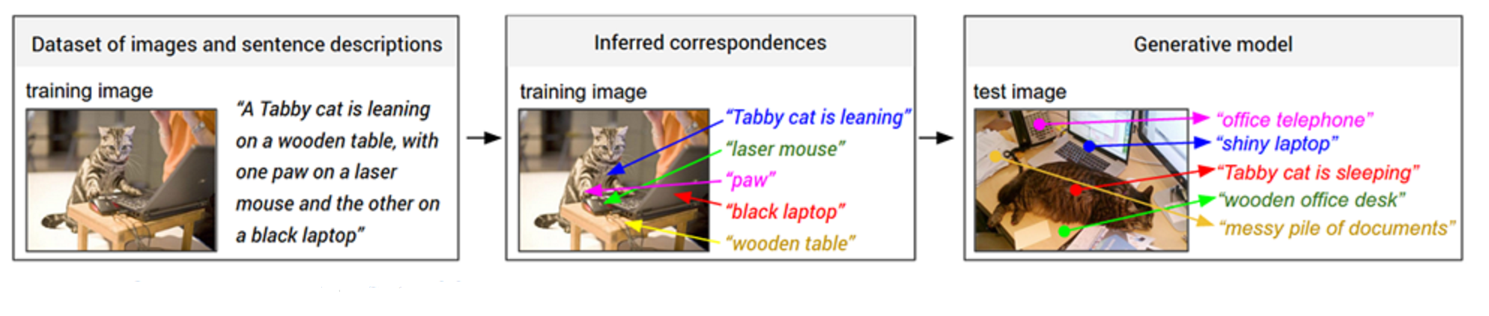
Generating Image Descriptions (CNN-RNN)
*https://arxiv.org/pdf/1412.2306v2.pdf
Notes:
Andrej Karpathy and Fei-Fei Li created this model
It combines the fields of Computer Vision and Natural Language Processing
It uses CNNs and bidirectional RNNs to generate natural language descriptions of different image regions

Slide 41
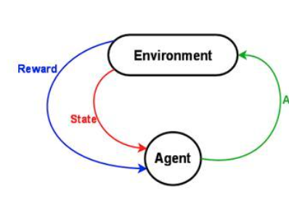
Deep Reinforcement Learning

Slide 42
Deep Learning – Some use-cases in next 5 years?

Slide 43
Advanced Melanoma Screening and Detection
Researchers at the University of Michigan are putting advanced image recognition to work, detecting one of the most aggressive, but treatable in early stages, types of cancer.
The team trained a neural network to isolate features (texture and structure) of moles and suspicious lesions for better recognition and detecting melanoma known to date.

Slide 44
Neural Networks for Brain Cancer Detection
A team of French researchers is working on spotting invasive brain cancer cells during surgery.
They found that using neural networks in conjunction with Raman spectroscopy during operations allows them to detect the cancerous cells easier and reduce residual cancer post-operation.

Slide 45
Neural Networks in Weather Forecasting and Event Detection
This traditional area for large-scale supercomputers is now becoming a hotbed for neural network development, particularly when it comes to weather event (pattern) detection.
In one such use case, computational fluid dynamics codes are matched with neural networks and other genetic algorithm approaches to detect cyclone activity.

Slide 46
Neural Networks in Finance
Trading and risk management are two areas where we would expect to see developments for neural networks
Popular technical indicators along with neural networks and genetic algorithms are used to generate buy and sell signals for each stock and for portfolios of stocks

Slide 47
What deep learning still can’t do?

Slide 48
What deep learning still can’t do
System 1: Fast and Parallel
With computer vision, we seem to be on the right track
Reinforcement learning is useful in increasingly large worlds
System 2: Slow and Serial
Still lacking in common sense
Language processing needs a grounded understanding

Slide 49
Limitations of deep learning
The encoded meaning is grounded with respect to other words.
There is no linkage to the physical world.
Bob went home.
Tim went to the junkyard.
Bob picked up the jar.
Bob went to town.
Where is the jar? A: town
Deep learning has no understanding of what it means for the jar to be in town.
For example that it can’t also be at the junkyard. Or that it may be in Bob’s car, or still in his hands.

Slide 50
Increasing Re-usability of Deep Learning models

Slide 51
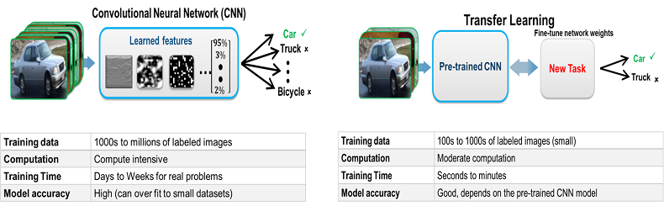
Transfer Learning & Fine-tuning
*http://www.mathworks.com/discovery/deep-learning.html?requestedDomain=uk.mathworks.com
Notes:
Transfer Learning is the process of taking a pre-trained model and “fine-tuning” the model with our own dataset

Slide 52
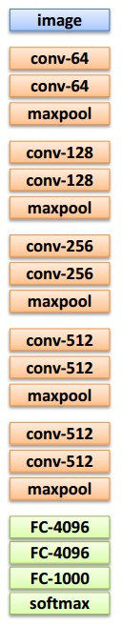
Transfer Learning
1. Train on
Imagenet
2. Small dataset:
feature extractor
3. Medium dataset:
finetuning
more data = retrain more of the network (or all of it)
Freeze these
Freeze these
Train this
Train this
*Andrej Karpathy’s recent presentation

Slide 53
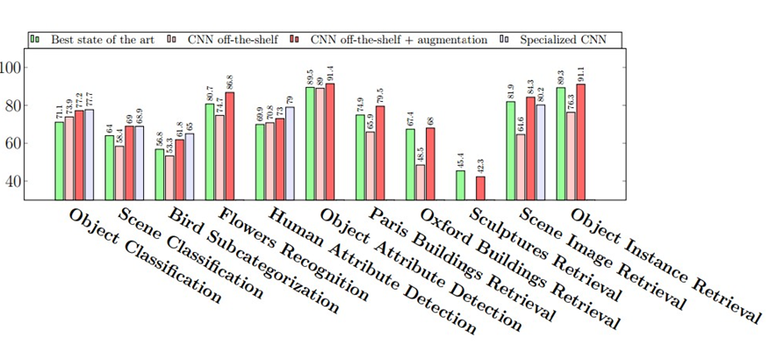
Transfer Learning
CNN Features off-the-shelf: an Astounding Baseline for Recognition
[Razavian et al, 2014]
*Andrej Karpathy’s recent presentation

Slide 54
Use Cases

Slide 55
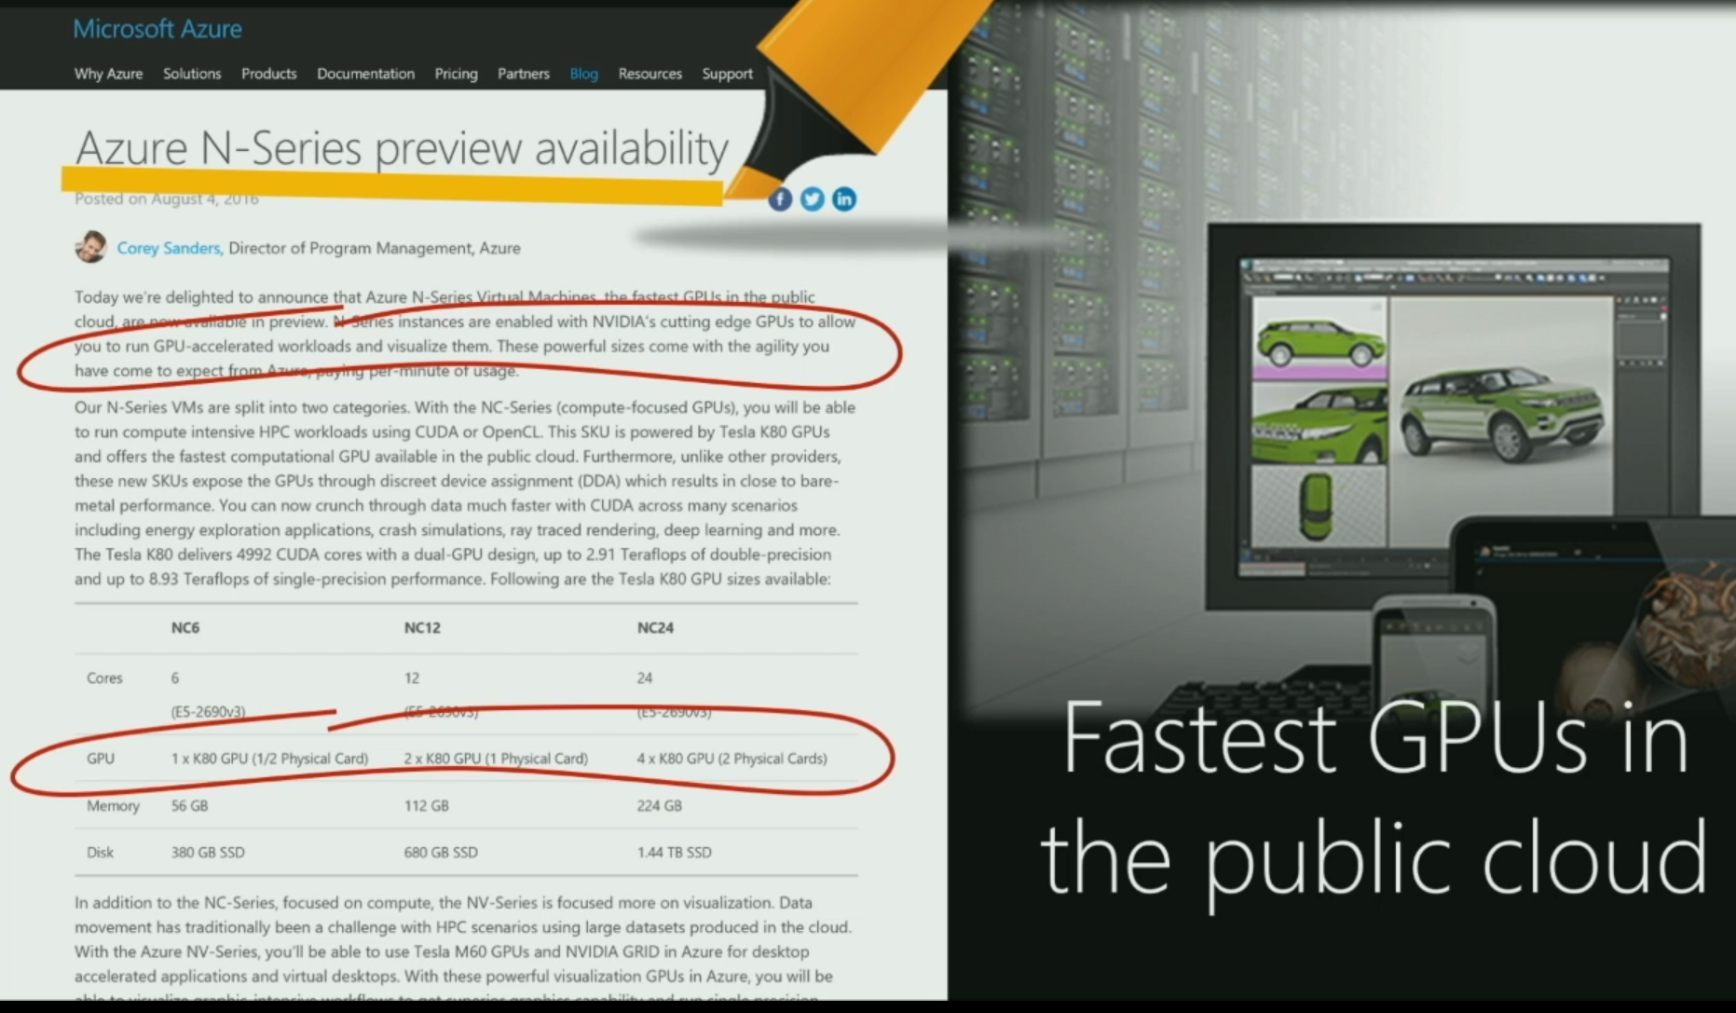
GPUs in Azure
Notes:
Azure introduced GPUs with its N-Series preview availability
There are 3 types on configurations available for deep learning tasks
NC6 with 1 X NVIDIA Tesla K80 GPU
NC12 with 2 X NVIDIA Tesla K80 GPUs
NC24 with 4 X NVIDIA Tesla K80 GPUs

Slide 56
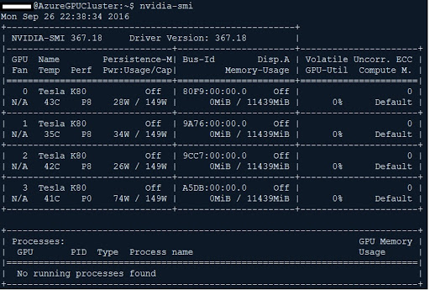
Azure GPU VM
Used Ubuntu 16.04 N-Series VM
NC24 VM with 4 NVIDIA Tesla K80

Slide 57
DL Framework: MXNET
DL toolkit by DMLC (2015)
Supports almost all common DL models
Supports multi-GPU training
Supports distributed training
Python/R support

Slide 58
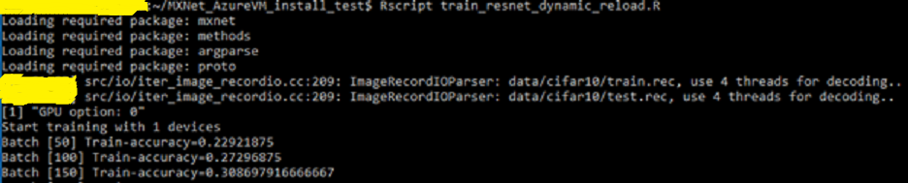
Case Study I: ResNet on CIFAR 10
Based on Microsoft Blog on how to use MXNET with MRO/MRS
Used MXNET with MRO and 1 GPU
*Tao Wu and Team, Microsoft
Notes:
This case study is based on a Microsoft Blog by Tao wu and Team
They explain step by step how to setup MXNET with Microsoft R Server (MRS)
Then they run an R script to train Resnet on CIFAR 10 dataset (as we can see from the image)

Slide 59
Case Study II: Finetuning pre-trained Inception BN Network
Used an ImageNet pretrained Inception BN Network
Used MXNET with anaconda python and 4 GPUs
Try to predict contents of a new unseen image

Slide 60
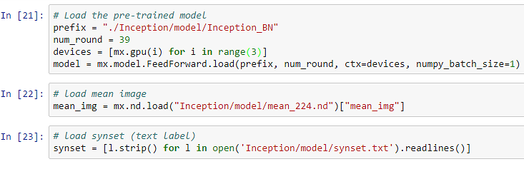
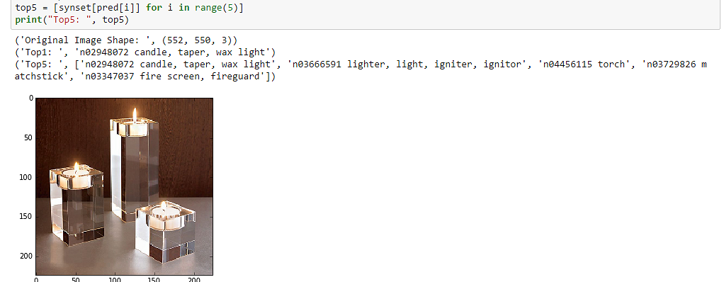
Using trained Inception BN Model

Slide 61
DL Framework : Theano (Lasagne/Keras)
Developed by a group at Université de Montréal (2007)
Easy to customize with domain-specific data
Experimental multi-GPU support (through Platoon)
Experimental distributed (only through Keras)
Great Python support

Slide 62
Case Study III: Diabetic Retinopathy Prediction
Used labeled fluorescein angiography images of eyes to improve Diabetic Retinopathy (DR) prediction (Kaggle)
Used a DCNN to improve DR prediction
Used Theano+Lasagne+Keras with anaconda python and 1 GPU

Slide 63
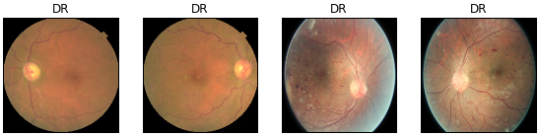
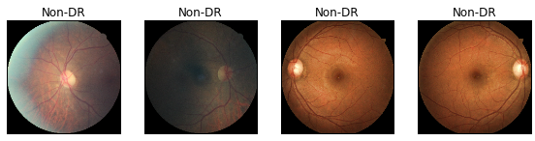
Diabetic Retinopathy

Slide 64
Fine-tuning DCNN model
ImageNet pre-trained GoogleNet
Trained ImageNet features transferred as initial weights for DR prediction.
Lower layers (first 2 layers) of the pre-trained DCNN contain generic features/weights that can be used for the DR prediction task.

Slide 65
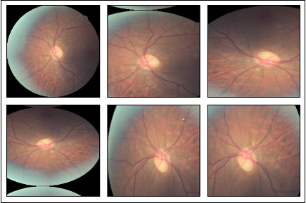
Reduce Overfitting: Augmentation

Slide 66
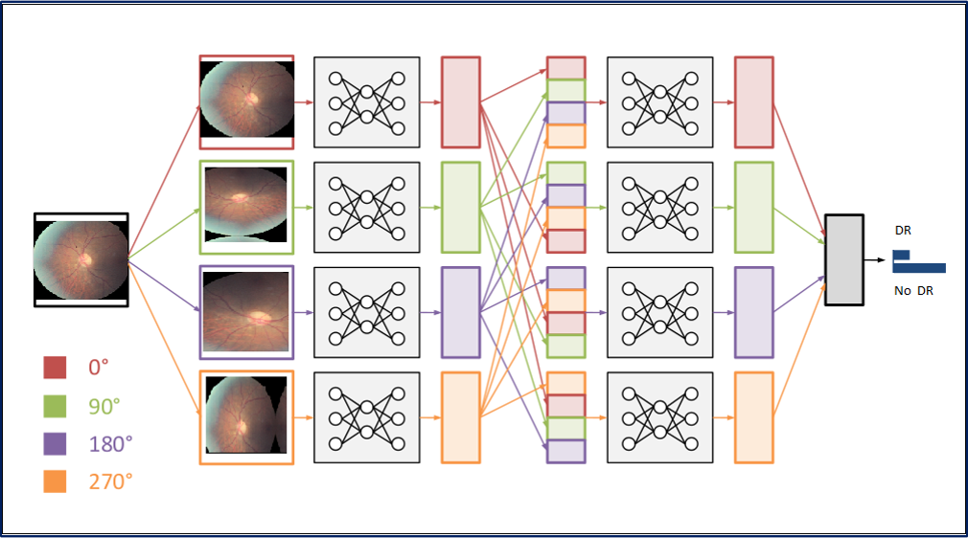
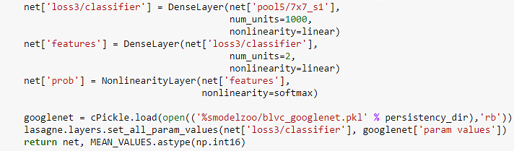
Transfer Learning DCNN
*http://benanne.github.io/2015/03/17/plankton.html

Slide 67
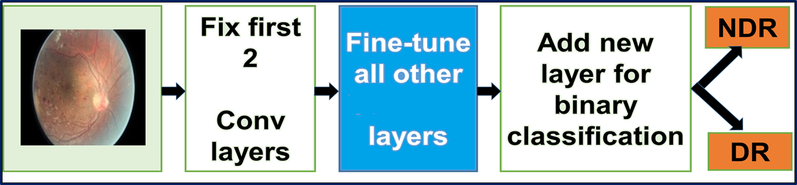
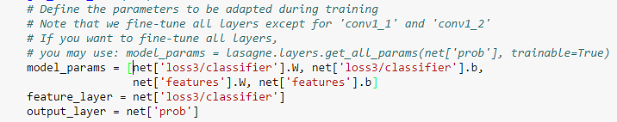
Fine-tuning GoogleNet

Slide 68
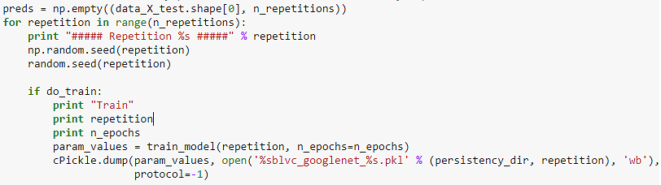
Training Fine-tuned DCNN model

Slide 69
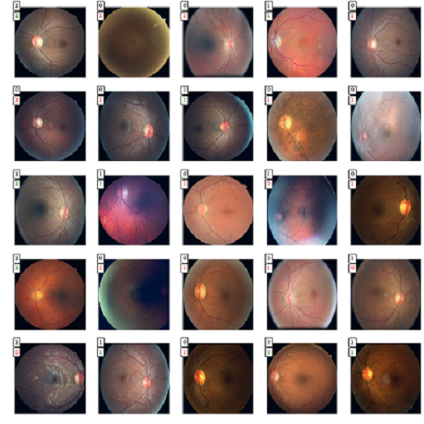
Diabetic Retinopathy Prediction
Epoch 449: Train cost 8.994, Train acc 0.607, val acc 0.798, val AUC 0.849

Slide 70
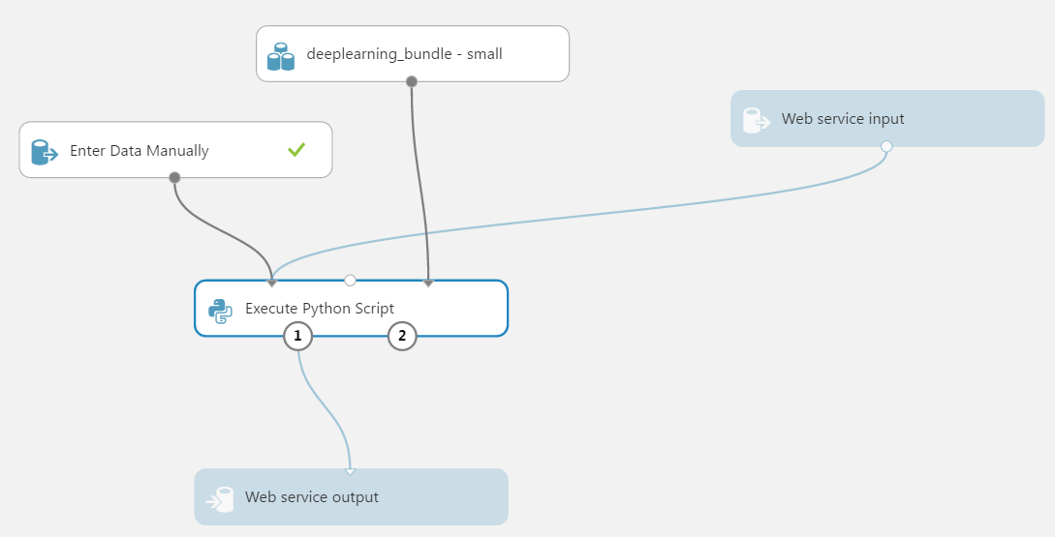
Using GPU-Trained model in AML

Slide 71
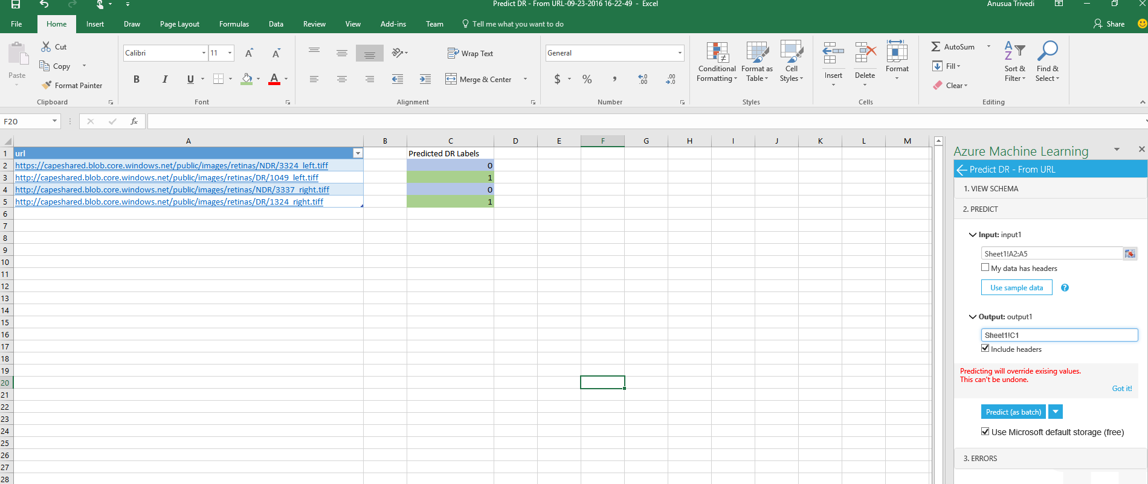
AML Web Service Batch-Test

Slide 72
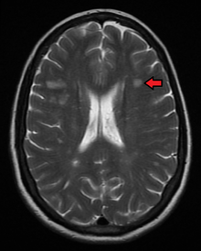



Other Uses of this DCNN Model

Slide 73
Case Study IV: Image Caption Generation
Used the ImageNet-trained DCNN and learn MS COCO image features through transfer learning and fine-tuning
Used a Long short-term memory (LSTM) Recurrent Neural Network (RNN) on these learned image features for the image caption generation

Slide 74

Deep CNN-RNN Model

Slide 75


Caption generation using fine-tuned CNN-RNN model

Slide 76
Re-usability of this CNN-RNN Model
Used CNN-RNN model for natural image caption generation
Can use the same CNN-RNN model in a completely different domain

Slide 77
Case Study V: Fashion Image Tag Prediction
We use the ImageNet-trained DCNN and learn Apparel Classification with Style (ACS) image features through transfer learning and fine-tuning
Then we use a Long short-term memory (LSTM) Recurrent Neural Network (RNN) on the learned image features for the image caption generation

Slide 78

Augmentation + Transfer Learning

Slide 79
Using the same CNN-RNN Model

Slide 80

ACS Images Tag Prediction

Slide 81


Using fine-tuned CNN-RNN model

Slide 82
DL Framework: TensorFlow
DL toolkit by Google (2016)
Supports all common DL models
Supports multi-GPU training
Supports native distributed training
Great Python Support

Slide 83

Case Study VI: Transfer Learning on pre-trained AlexNet

Slide 84

Training on Cats & Dogs Images

Slide 85

Validating on Cats & Dogs Images

Slide 86

Classifying Cats & Dogs

Slide 87


Case Study VII: Similar Image Retrieval

Slide 88

Case Study VIII: Similar Image Retrieval

Slide 89
Demos/Hands-on

